Slide 1
GrizzTime - Sprint 1
Misael Hernandez, Melissa Palmer, Daniel Salar, Gurnirunjun Shergill, Anthony Robin

Slide 2
Sprint 1:
User stories for this sprint:
  User account creation
  Sign in/Sign Out
  Profile update
  Email verification
Must complete all UI/UX for next sprint

Slide 3
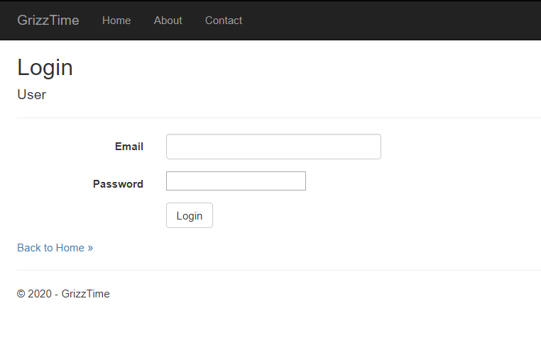

Slide 4
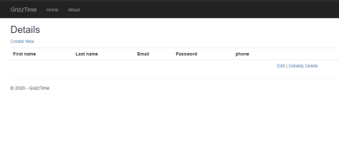

Slide 5
Tool Chain and Languages
Tool chain: Git, Visual Studio, BootStrap/CSS
Languages and Frameworks: ASP.NET - MVC
Front End: html css with Bootstrap
Back End: .NET
Database: MySQL
Server: Local for now
Planning: Monday.com

Slide 6
Config Management, Server Setup, and Development Environment
Config Management: Github, Git
Server Setup: Local servers for now, MS Azure later
Development Environment: Visual Studio, but collaborating via Git

Slide 7
Risks and Challenges
Understanding ASP.NET MVC Framework
Setting up email authentication through smtp
Locally hosted created issues when testing on local machines
Using Git with different branches

Slide 8
Next step
Sprint 2:
User stories for this sprint:
  Finalize creation of all entities in the database
  Ability to create
    Project
    Business
  Ability to register under business
Must complete all UI/UX for next sprint,
Must create all QA tests for user authentication system

Slide 9
Thank you

